Slide 1
Weekly meeting 16
Shengya Guo, CR/AVS3, 18.10.2024

Slide 2
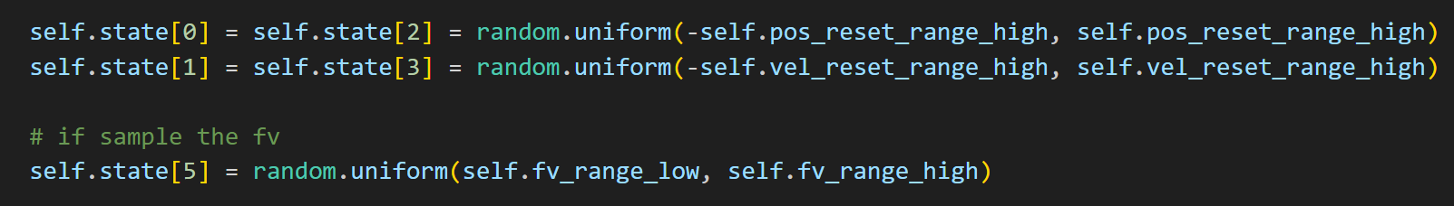
Randomly restart at point around 0

Slide 3
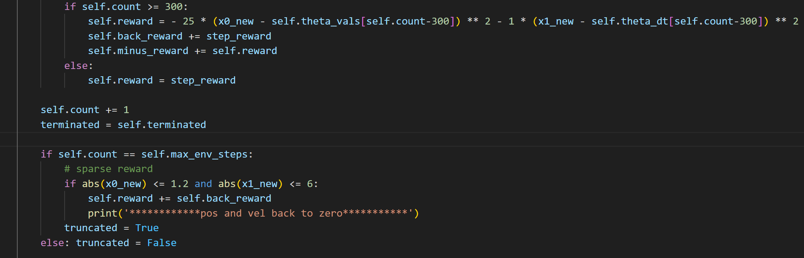
Two phase reward function
Reshape the reward function
First phase: 0 to 300ms, step reward based on FIM
Second phase: 300 to 500ms, step reward(minus) based on the trajectory which leads the motor back to the start point
Record the accumulating FIM step reward from 300ms to 500ms, if the motor successfully back to the start point with a tolerance in the end, add it to the episode reward

Slide 4
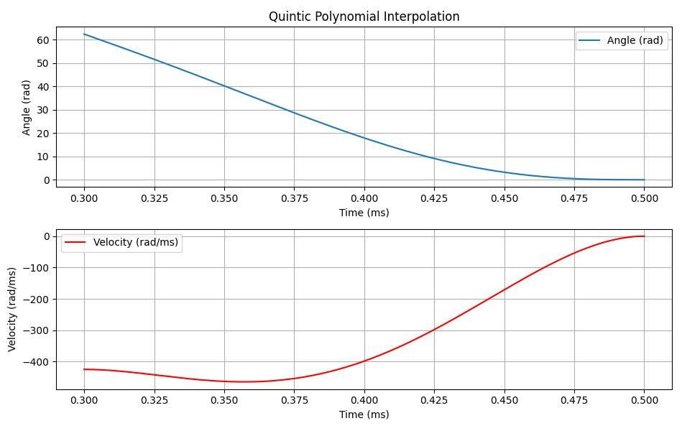
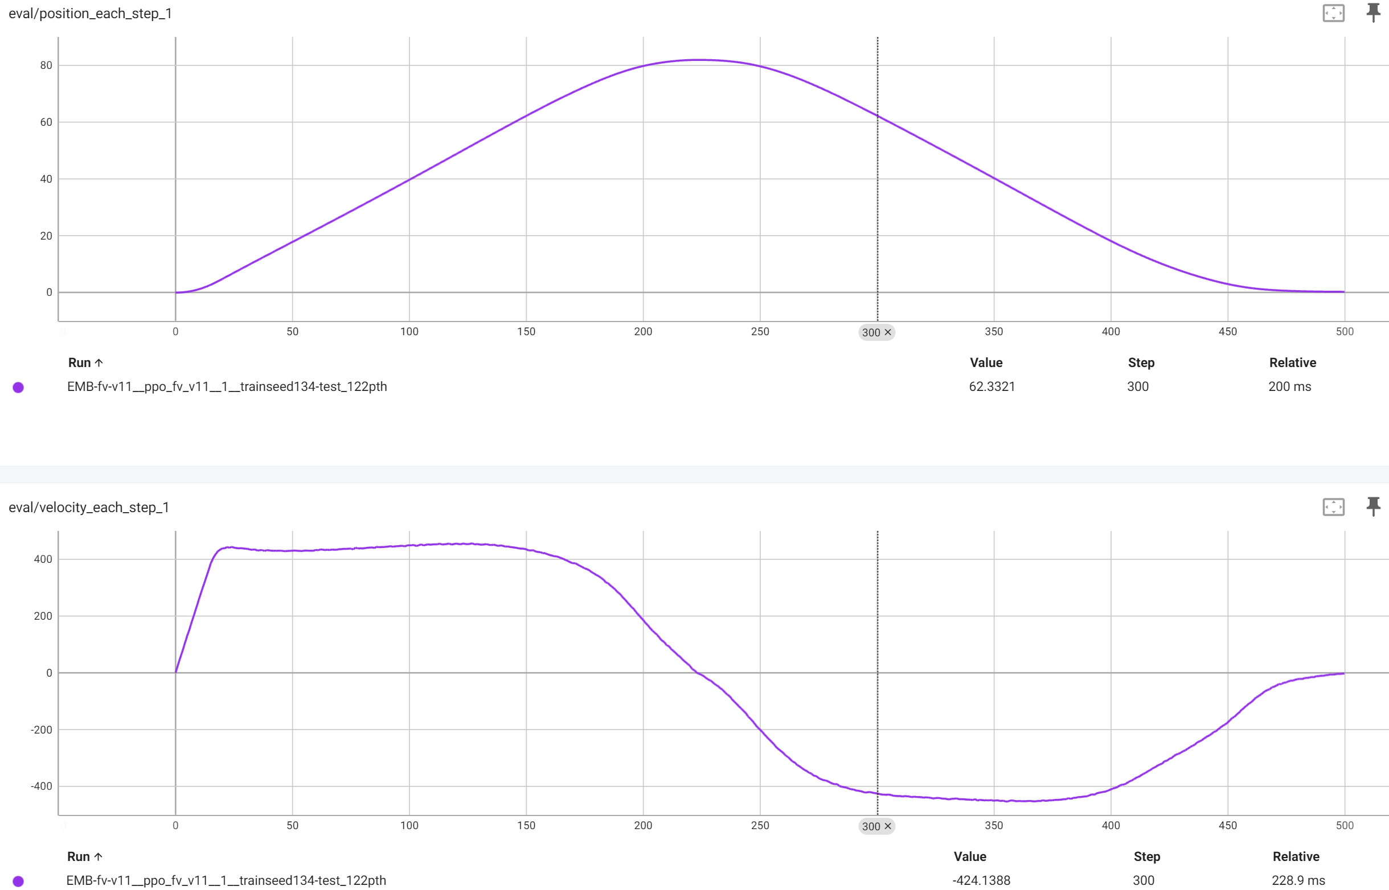
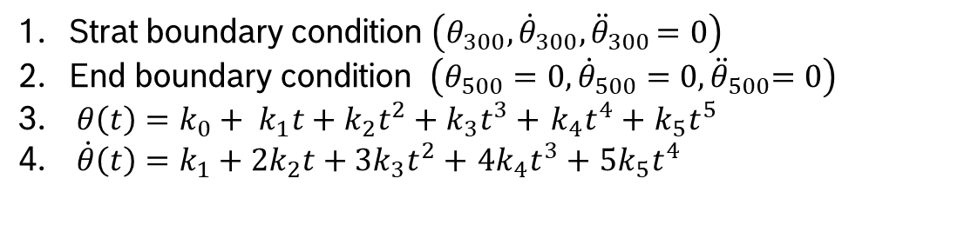
Quintic polynomial
Design of the reset trajectory
Strat boundary condition $\left(θ_{300}, {\dot{θ}}_{300}{, \ddot{θ}}_{300}=0\right)$
End boundary condition $\left(θ_{500}=0, {\dot{θ}}_{500}{=0, \ddot{θ}}_{500}=0\right)$
$θ\left(t\right)={{k_{0}+ k}_{1}t+k}_{2}t^{2}+k_{3}t^{3}+$ $k_{4}t^{4}+$ $k_{5}t^{5}$
$\dot{θ}\left(t\right)={k_{1}+2k}_{2}t+{3k}_{3}t^{2}+$ ${4k}_{4}t^{3}+$ ${5k}_{5}t^{4}$

Slide 5
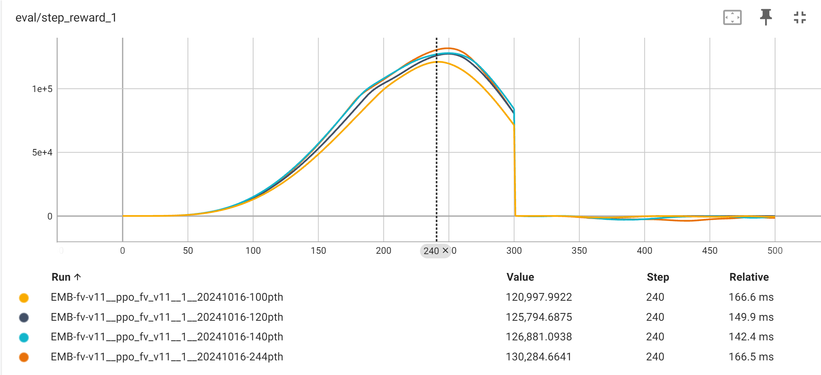
In first 300ms
Observation from 2M steps training
Model saved with checkpoint 20, 40, 60, …, 240, and 244
The agent focus on maxmail the reward in first 300steps

Slide 6
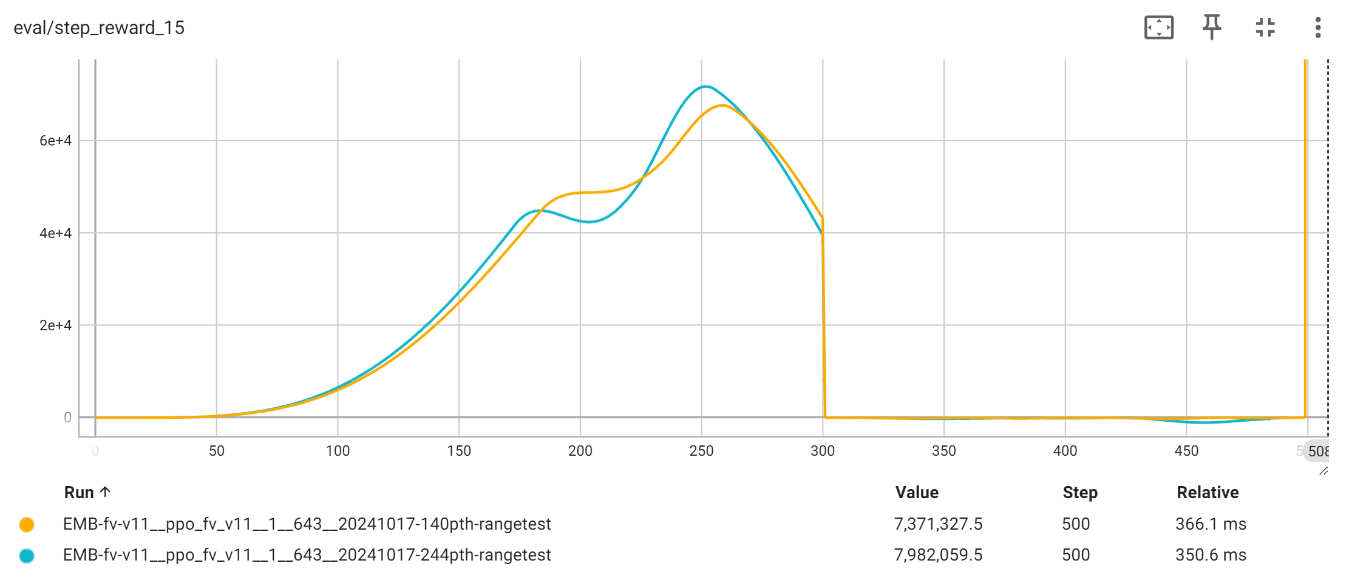
From 300ms to 500ms
Observation from 2M steps training
With the training going on, the agent take more risk in the last 300step, and won a higher onetime reward in the end

Slide 7
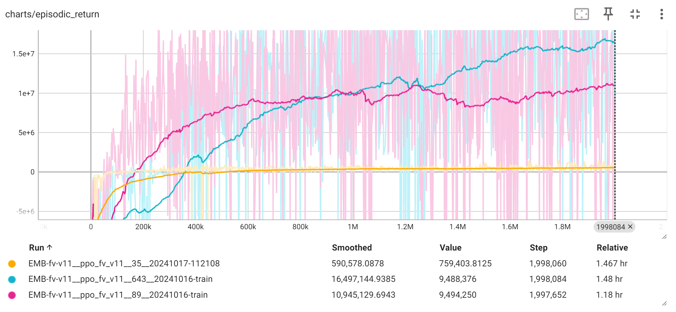
Stability of seeding
There is performance differences between seeds
4 different seed trained, 3 of them is good, 1 is not

Slide 8
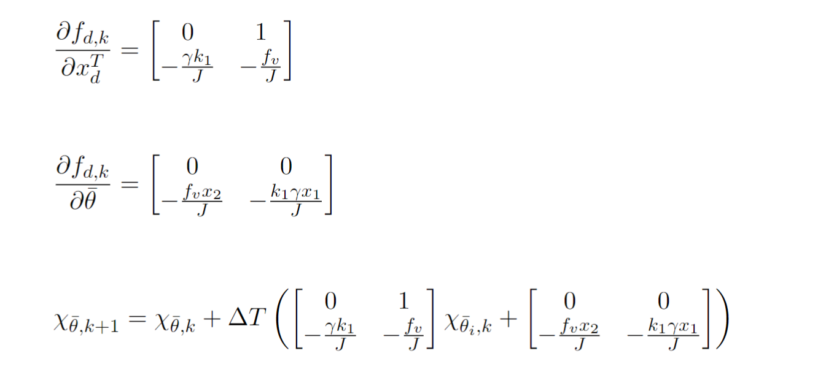
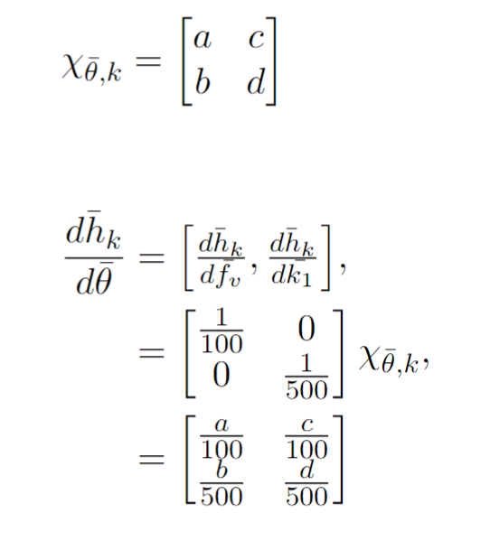
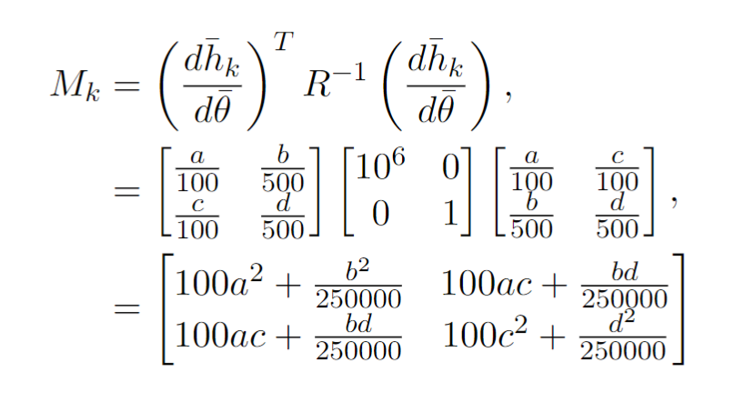
The caculation of FIM for two parameters

Slide 9

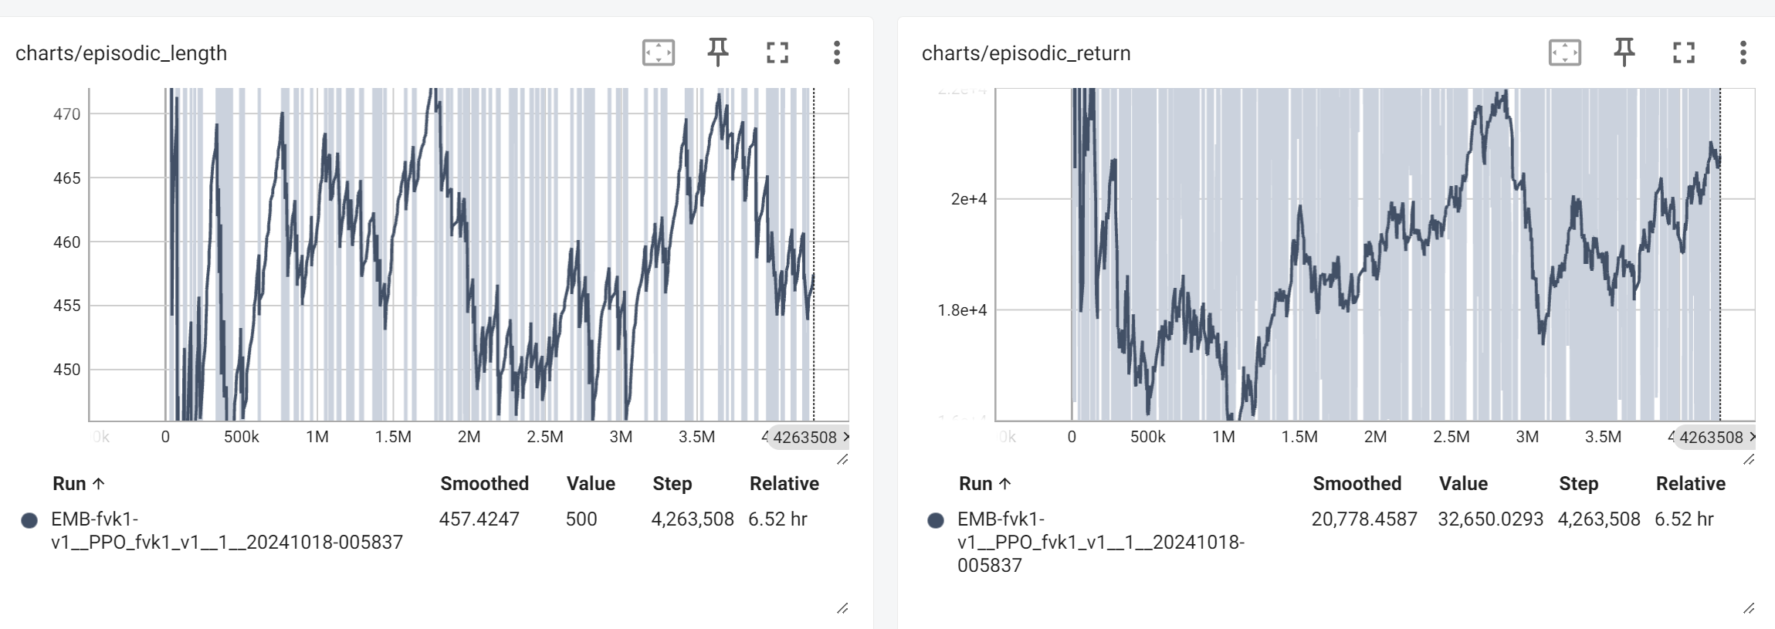
The reward function by two paramerts
The step reward changed
In the previous model, the step reared is small in beginning, but could reach 5e5 later
Now the logdet is used, and step reward is big in beginning, and small later
Also the value is smaller than 0.5
New parameters for the reward function needed

Slide 10
Next
Reshape the reward function with other parameter, to make it balance
Read the paper which use the EV to calculate the reward, could do the balance using min the max(e1,e2) of M^-1 between the speed(for fv) and the position(for k)

